Slide 1
CMSC204
Kartchner
V(StateGraph) = {Oregon, Alaska, Texas, Hawaii, Vermont, NewYork, California}
E(StateGraph) = {(Alaska, Oregon), (Hawaii, Alaska), (Hawaii, Texas), (Texas, Hawaii), (Hawaii, California), (Hawaii, New York), (Texas, Vermont), (Vermont, California), (Vermont, Alaska)}
1. Draw the StateGraph
Oregon
Texas
Vermont
New York
Alaska
Hawaii
California

Slide 2
a. Show the adjacency matrix that would describe the edges in the graph. Store the vertices in alphabetical order
Alaska California Hawaii New York Oregon Texas Vermont
Alaska
California
Hawaii
New York
Oregon
Texas
Vermont
0 0 0 0 1 0 0
0 0 0 0 0 0 0
1 1 0 1 0 1 0
0 0 0 0 0 0 0
0 0 0 0 0 0 0
0 0 1 0 0 0 1
1 1 0 0 0 0 0
3. b. Show the adjacency lists
that would describe the edges in the graph
Alaska
California
Hawaii
New York
Oregon
Texas
Vermont
Oregon
Alaska
California
New York
Texas
Hawaii
Vermont
Alaska
California

Slide 3
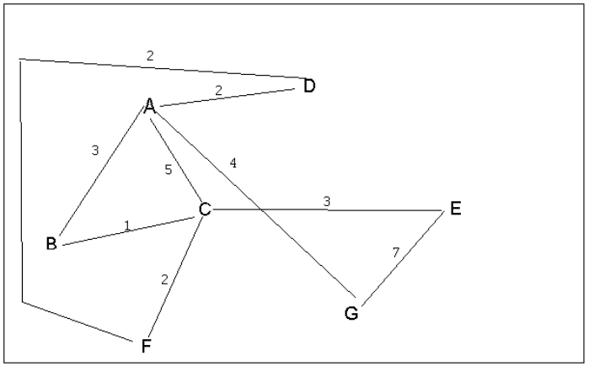
4 a. Which of the following lists the graph nodes in depth first order beginning with E?
A) E, G, F, C, D, B, A
B) G, A, E, C, B, F, D
C) E, G, A, D, F, C, B
D) E, C, F, B, A, D, G
Answer: C
4 b. Which of the following lists the graph nodes in breadth first order beginning at F?
A) F, C, D, A, B, E, G
B) F, D, C, A, B, C, G
C) F, C, D, B, G, A, E
D) a, b, and c are all breadth first traversals
Answer A

Slide 4
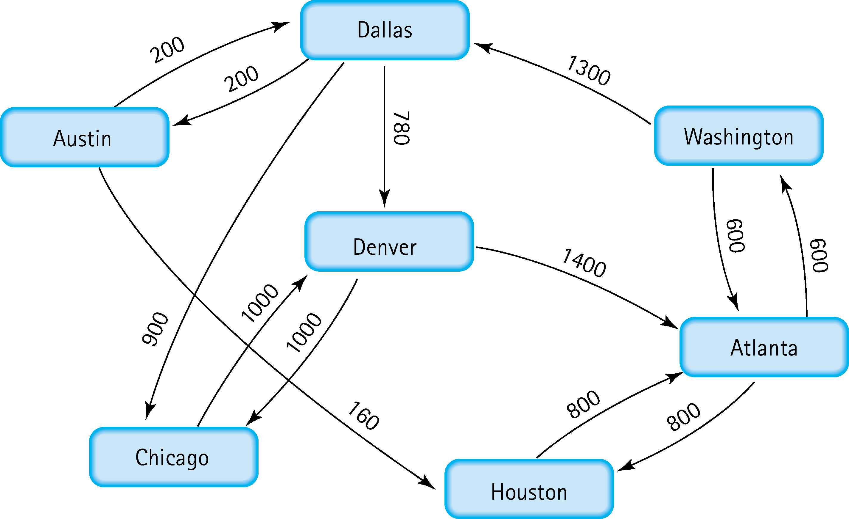
5. Find the shortest distance from Atlanta to every other city
Houston 800
Washington 600
Dallas 600 + 1300 = 1900
Denver 600 + 1300 + 780 = 2680
Austin 600 + 1300 + 200 = 2100
Chicago 600 + 1300 + 900 = 2800

Slide 5
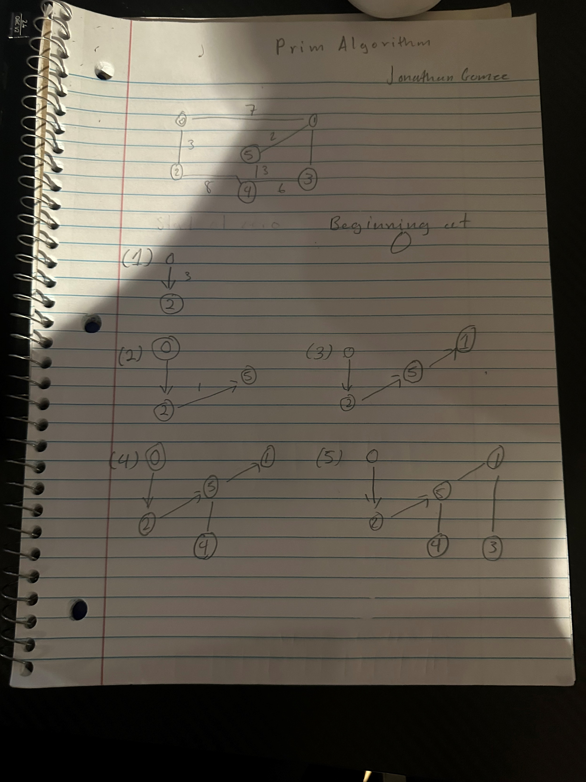
Proof of Work for number 6

Slide 6
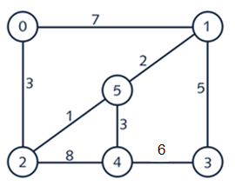
6. Find the minimal spanning tree using Prim’s algorithm. Use
0 as the source vertex . Show the steps.

Slide 7
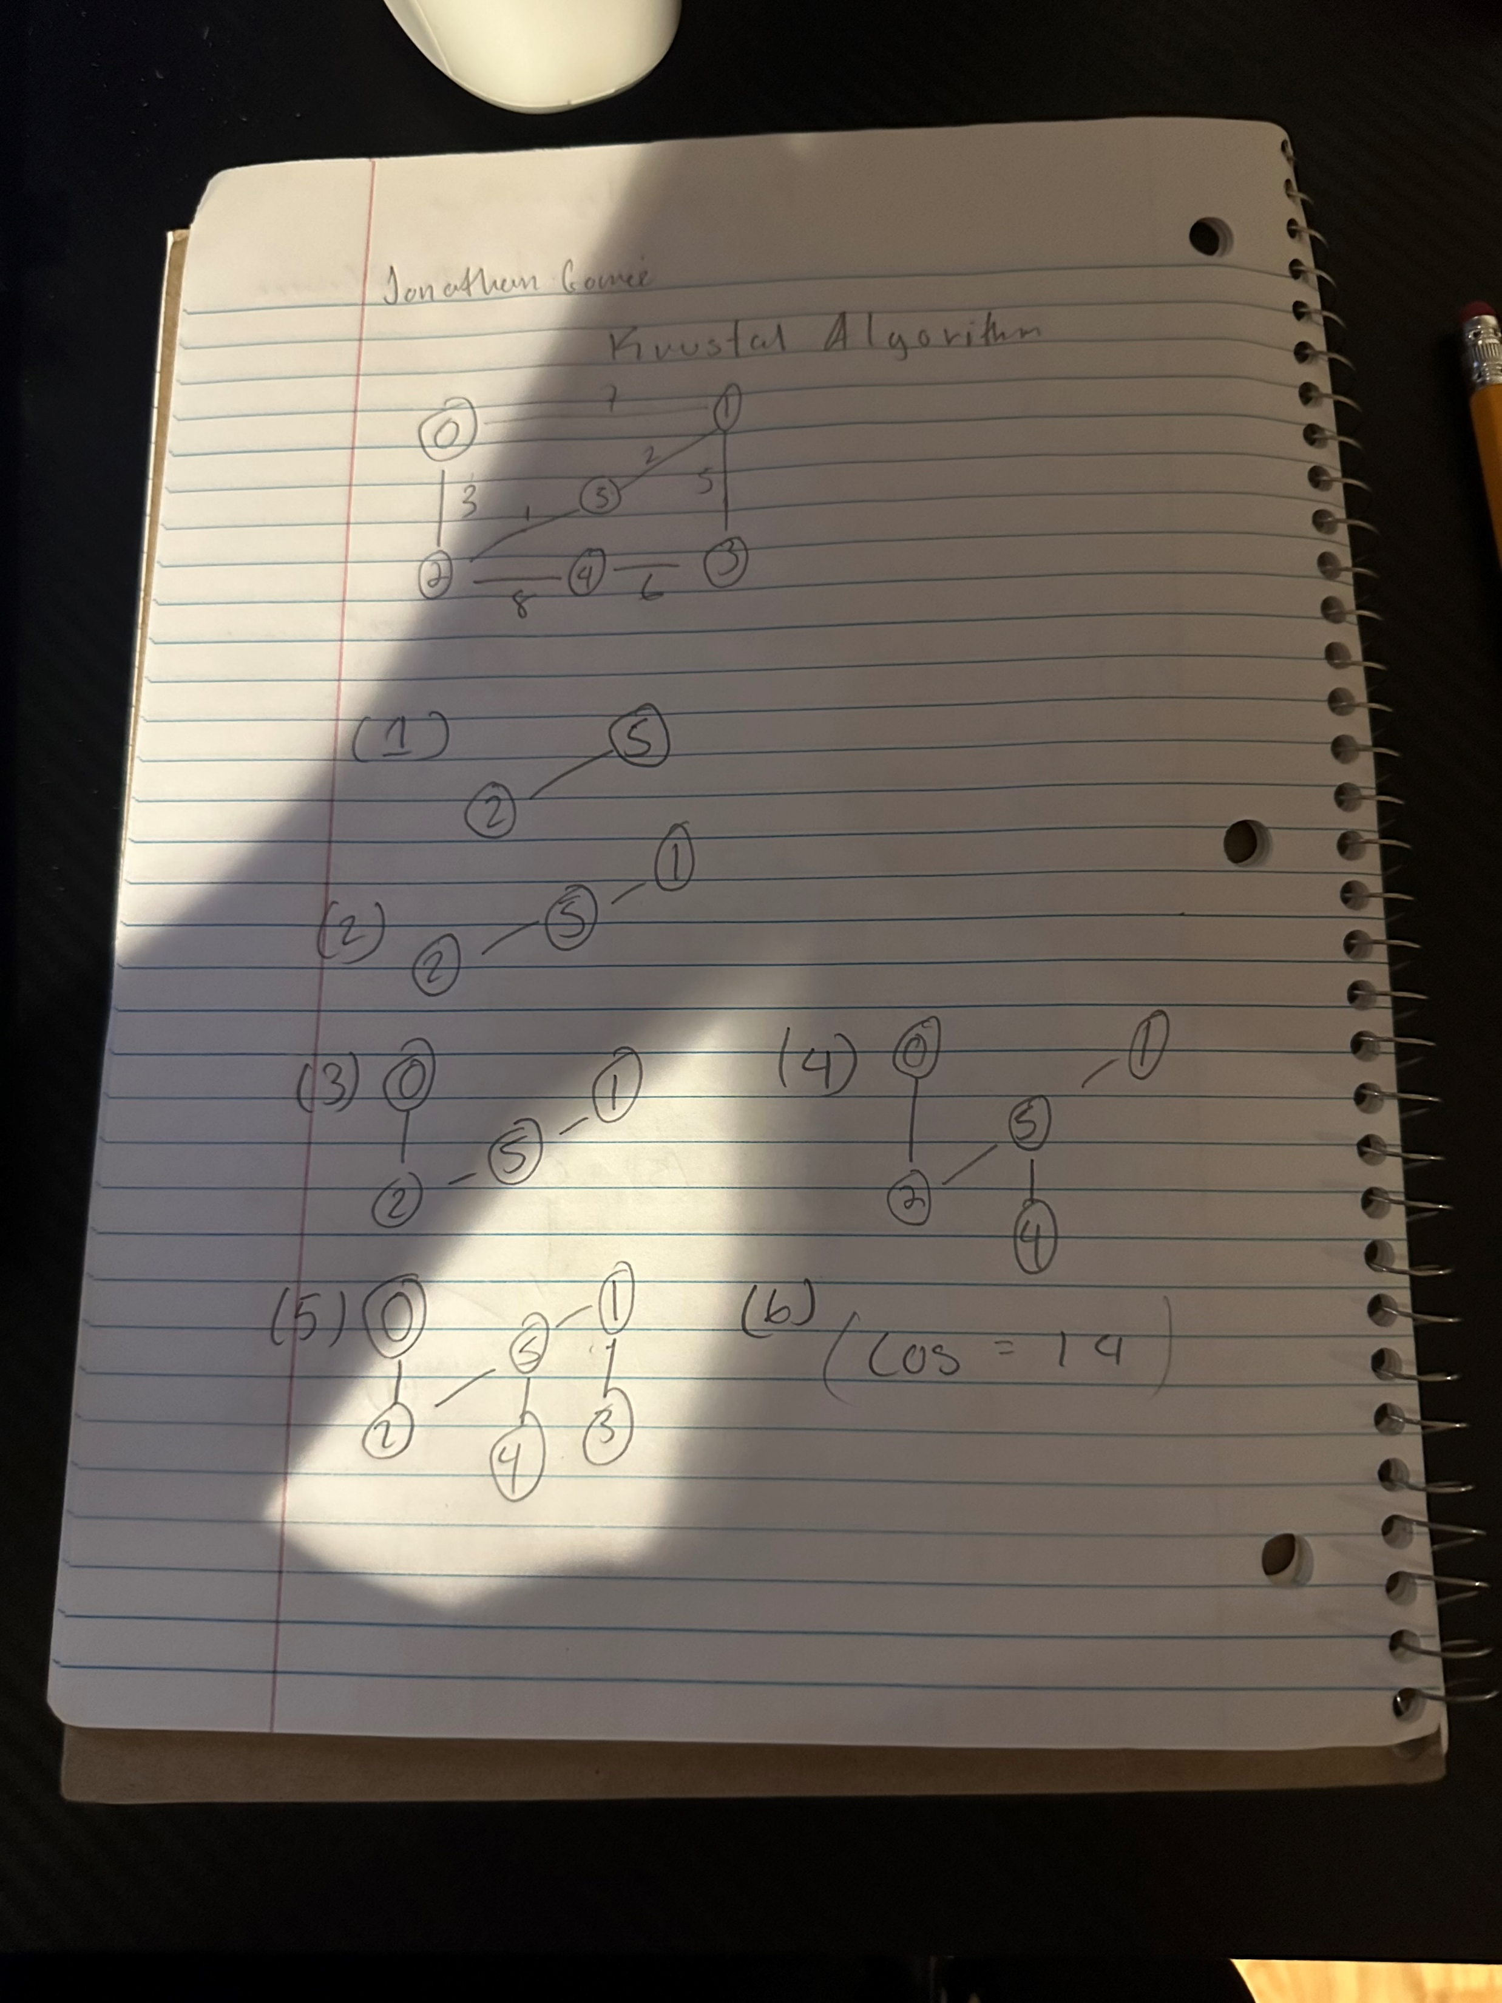
Answer for question 7

Slide 8
7. Find the minimal spanning tree using Kruskal’s algorithm.
Show the weights in order and the steps.

Slide 9
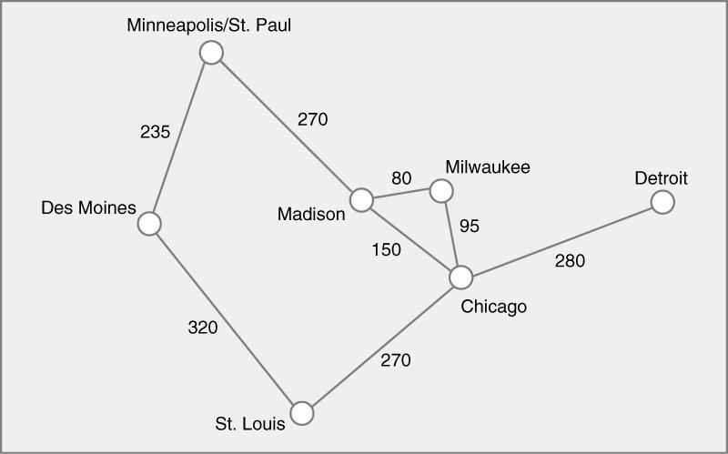

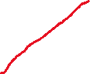
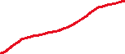

8. Find the minimal spanning tree using the algorithm you prefer. Use
Minneapolis/St. Paul as the source vertex
Total cost is 1230

Slide 10
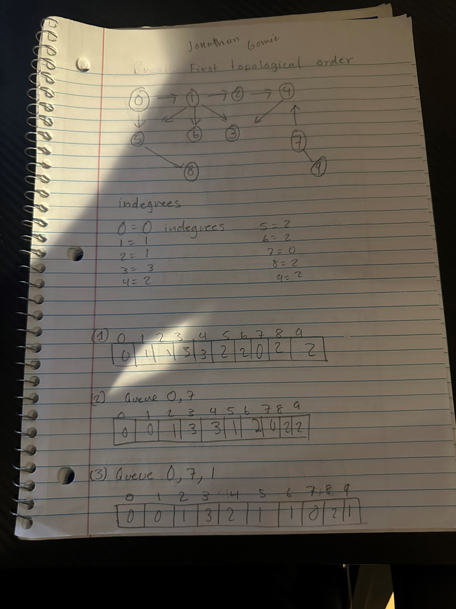

Slide 11
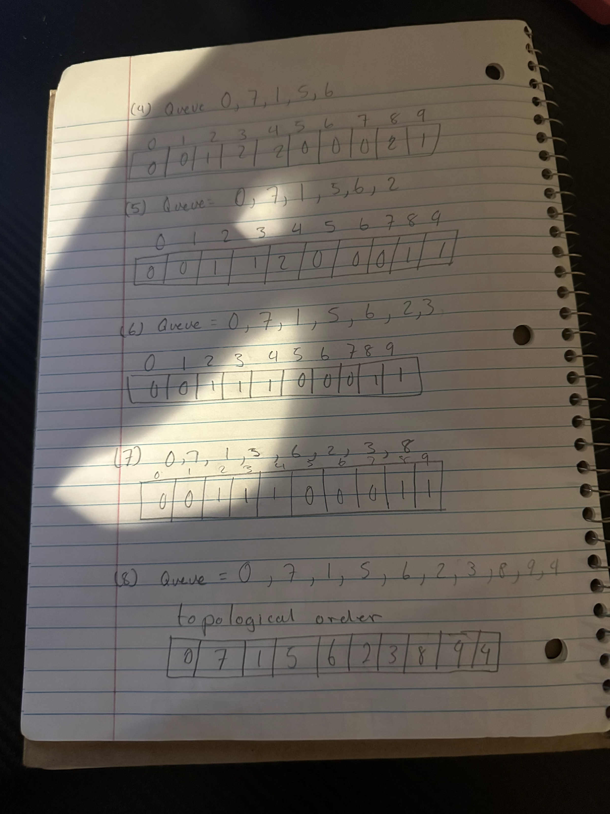

Slide 12
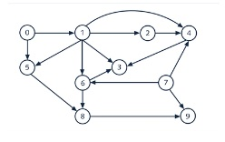
9. List the nodes of the graph in a breadth first topological ordering. Show the
steps using arrays predCount, topologicalOrder and a queue
Proof of Work are in the slides above this one

Slide 13
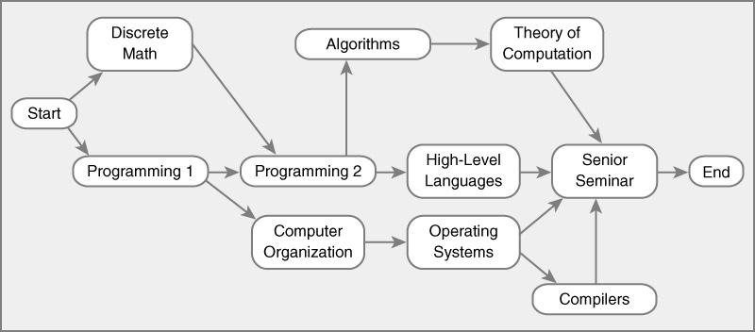
10. List the nodes of the graph in a breadth first topological ordering.
Start
Discrete Math
Programming 1
Programming 2
Computer Organization
Algorithms, High-Level Languages
Operating Systems
Theory Computation
Senior Seminar
Compilers
End

Slide 14
Screenshot of GitHub:

